Slide 1
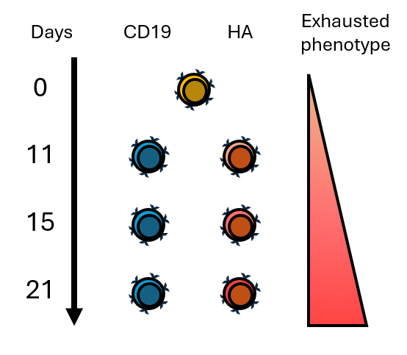
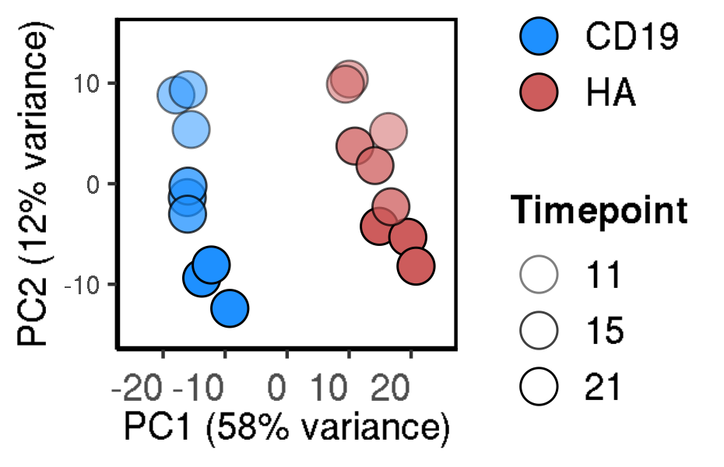
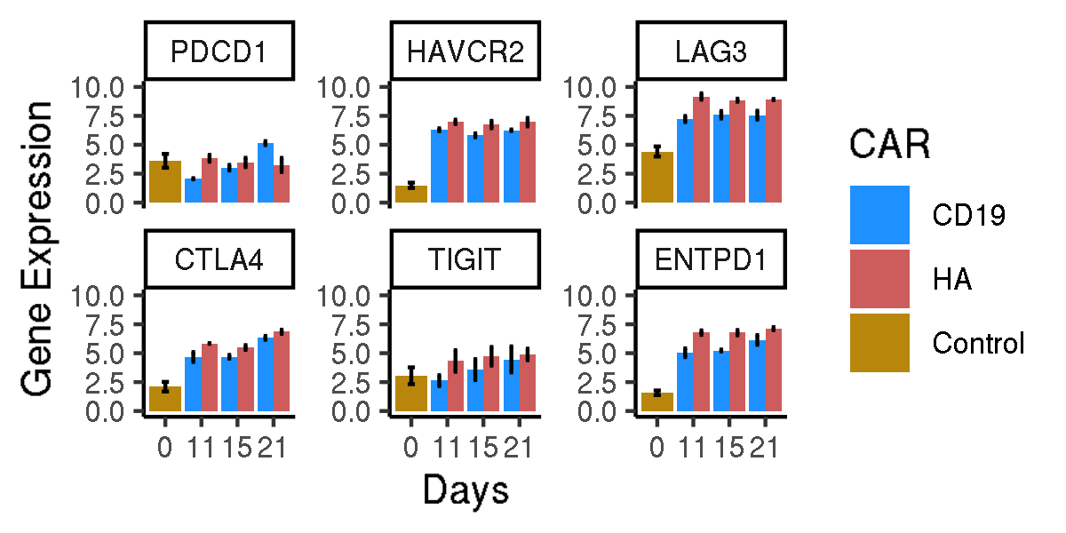
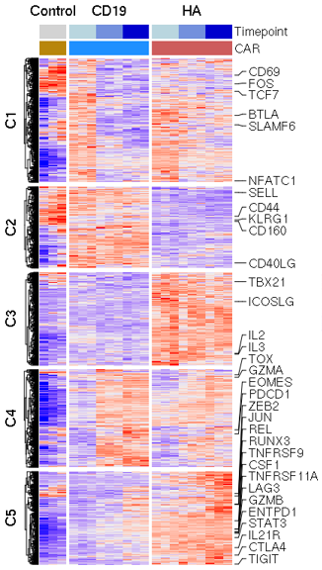
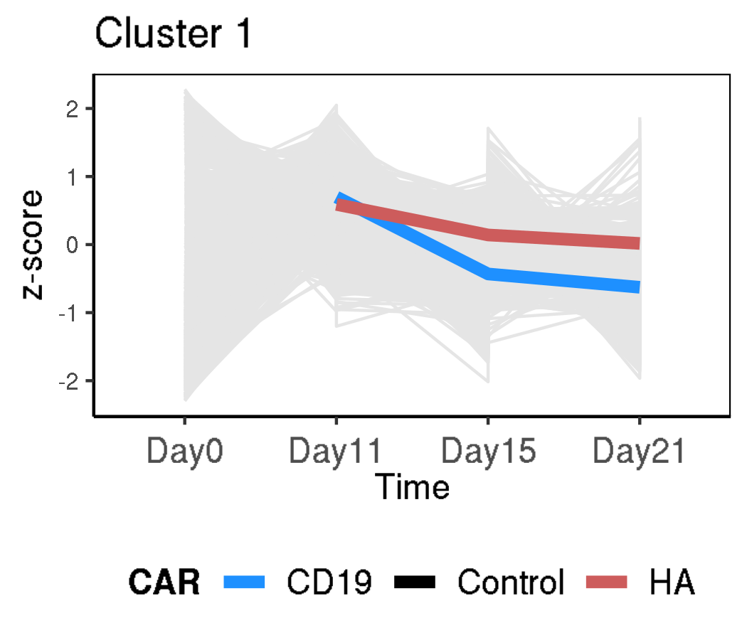
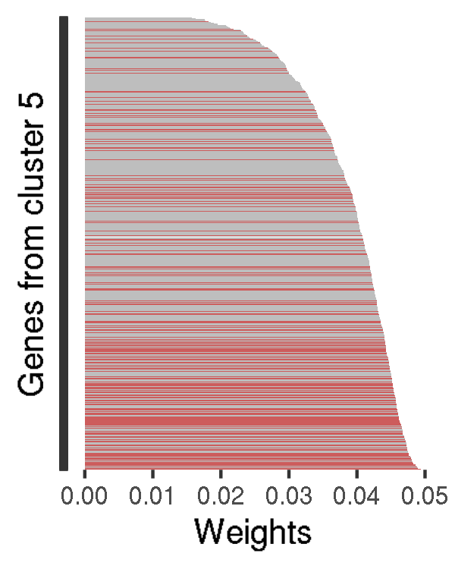
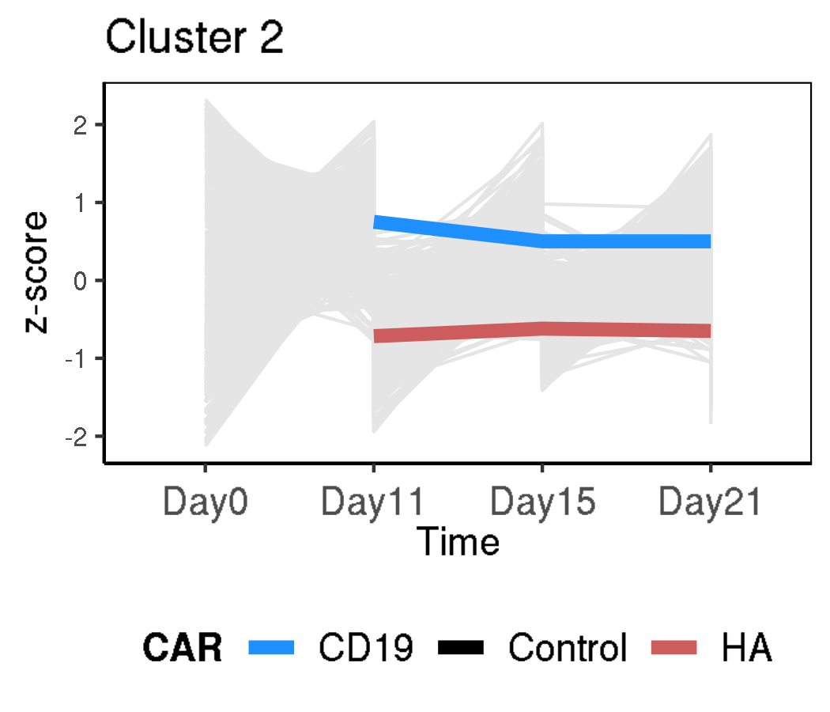
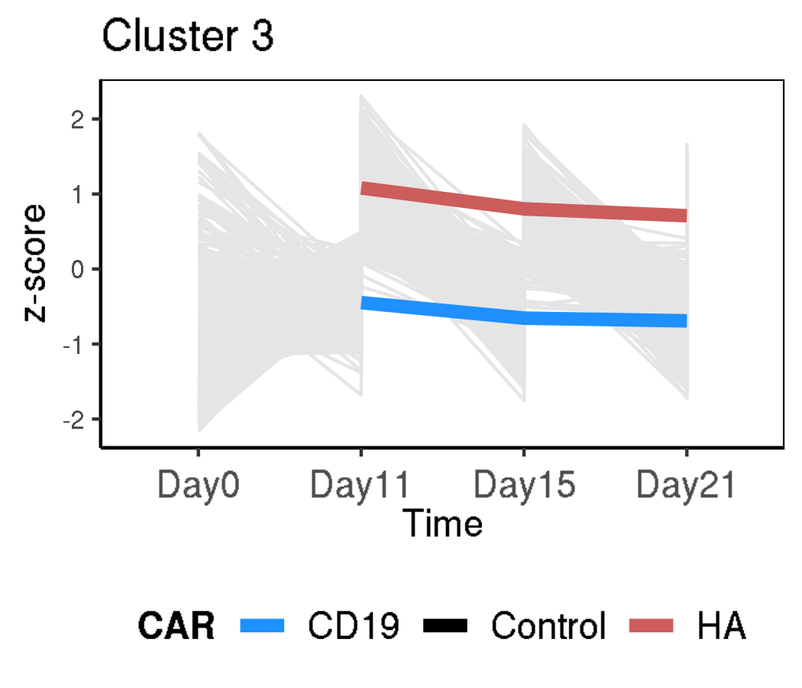
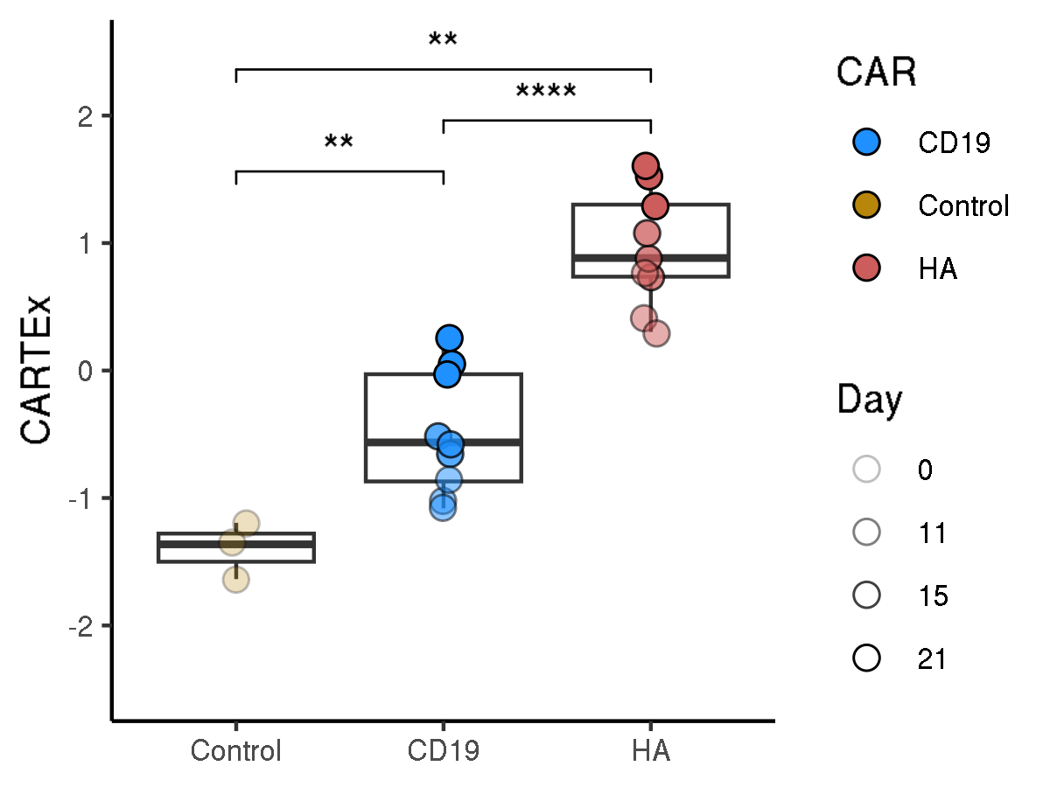
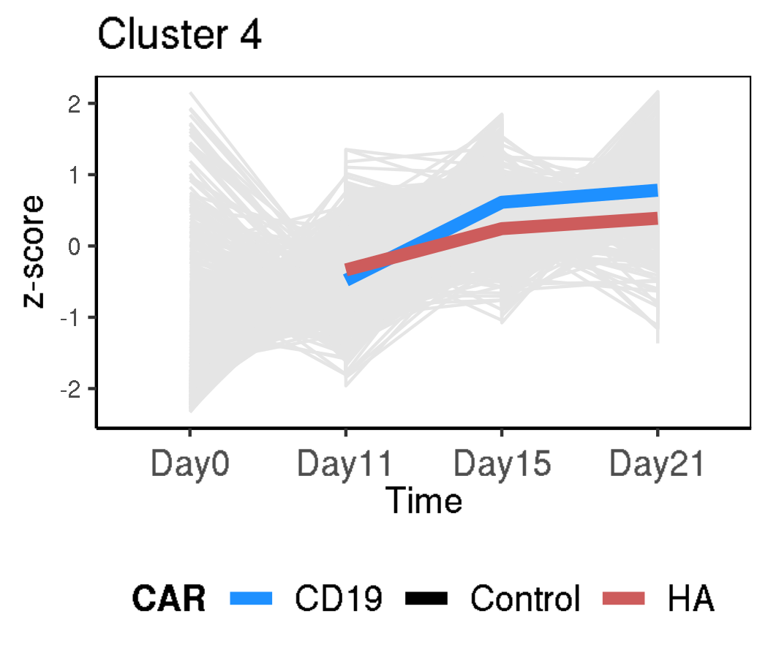
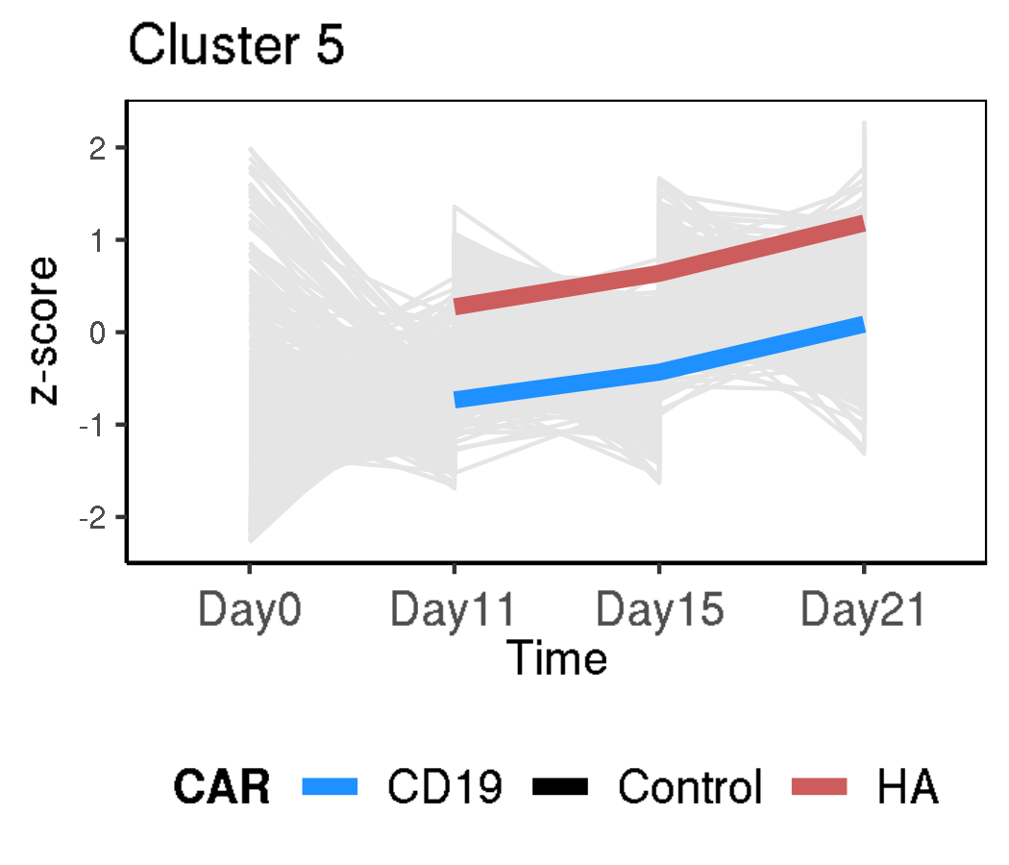
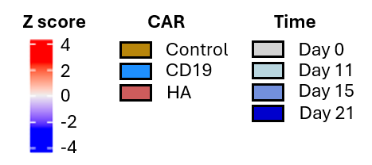
CARTEx project
Figure 1. Bulk RNA sequencing of functional and exhausted CAR T cells across 21 days
A
B
C
D
E
F
G

Slide 2
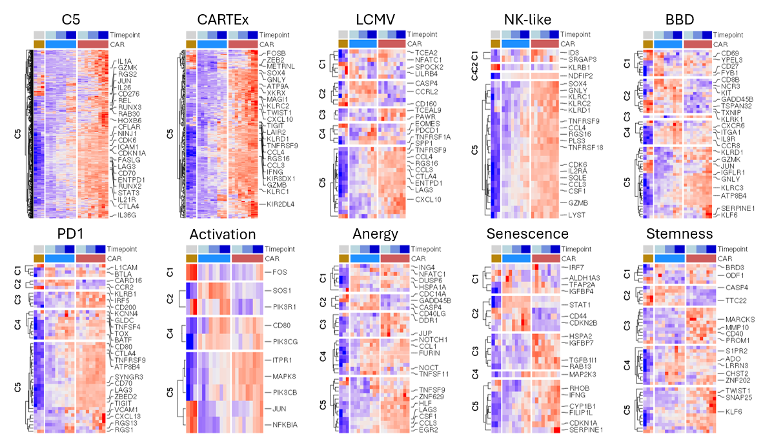
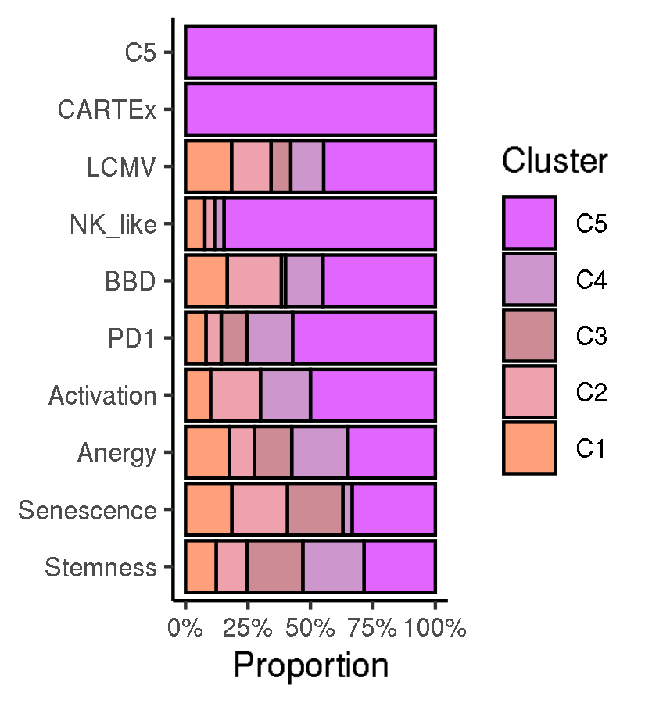
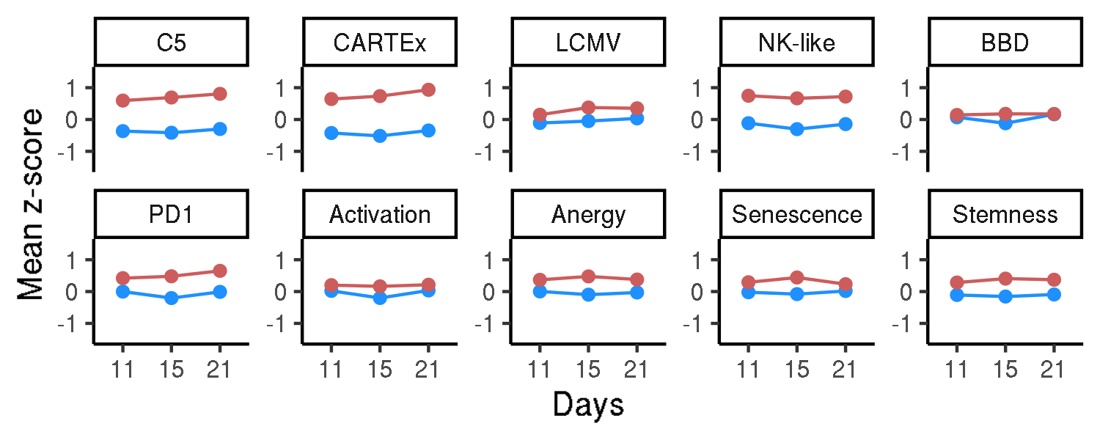
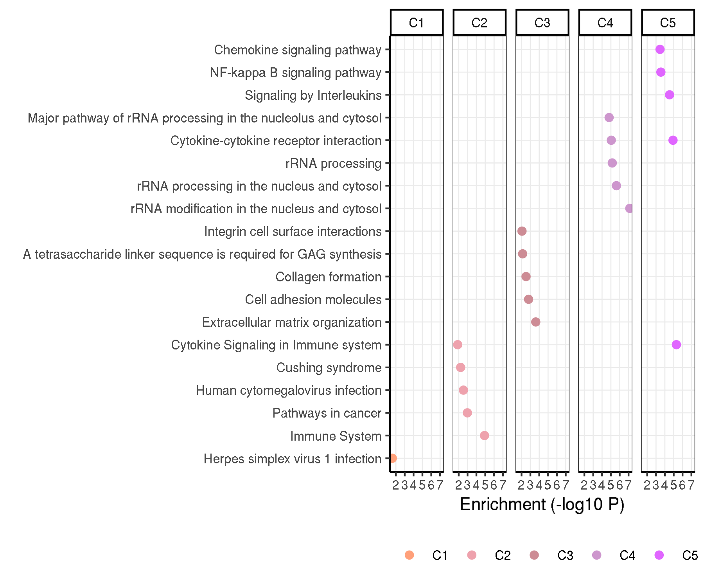
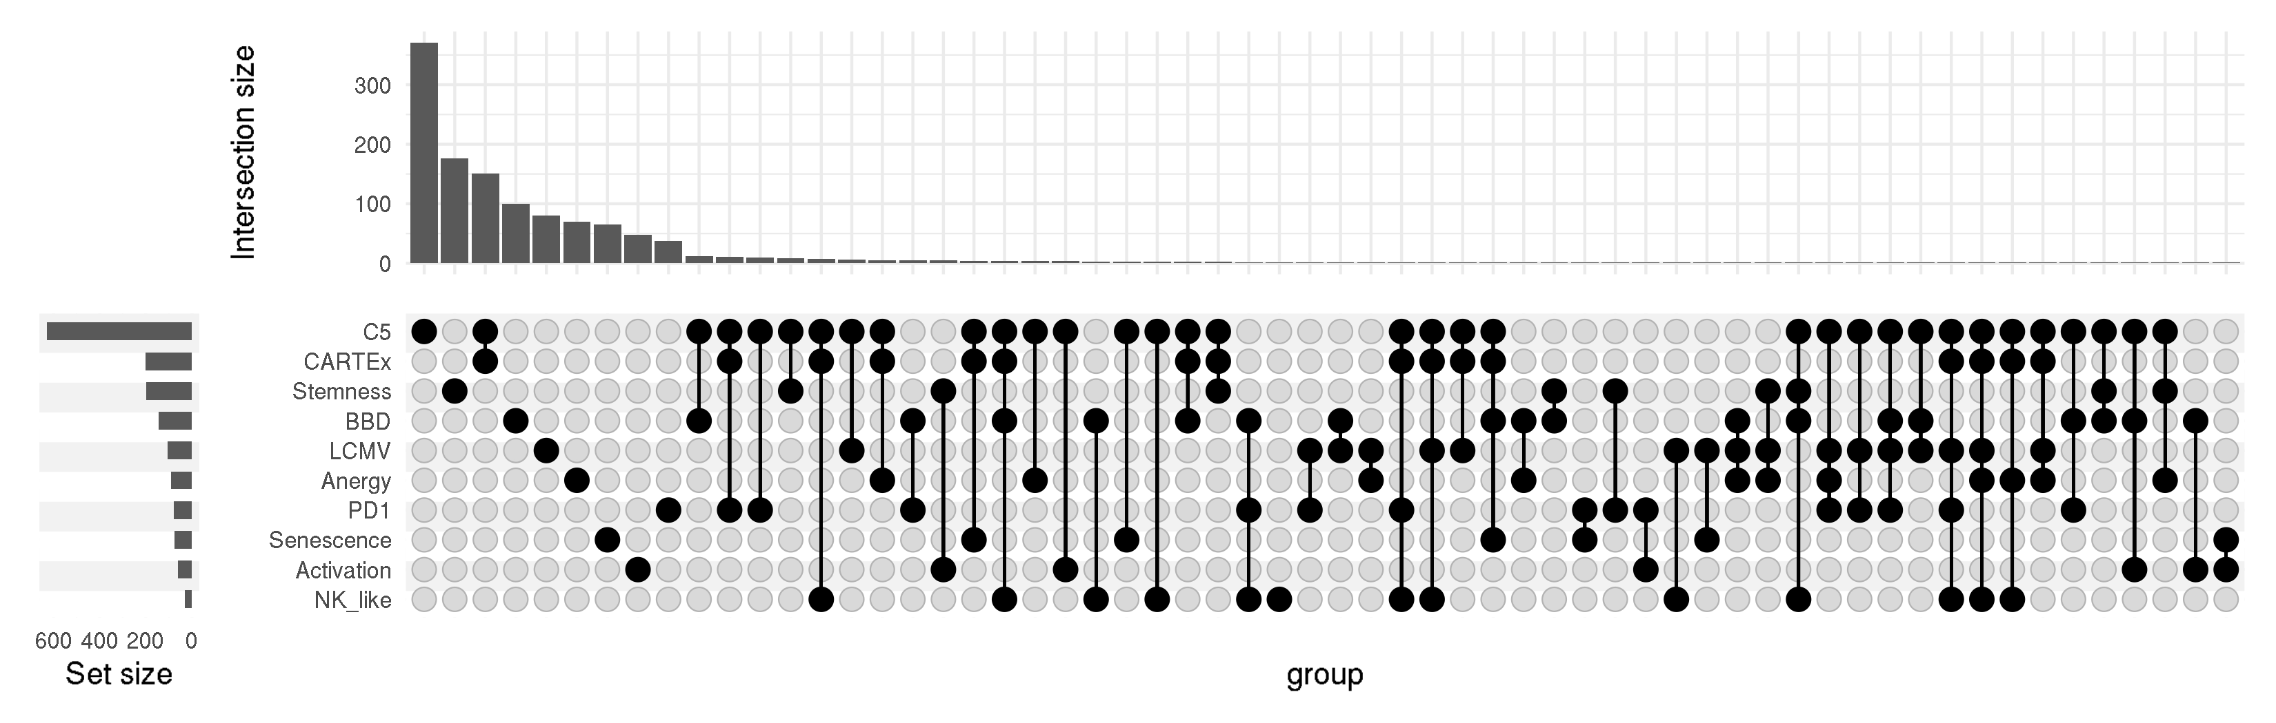
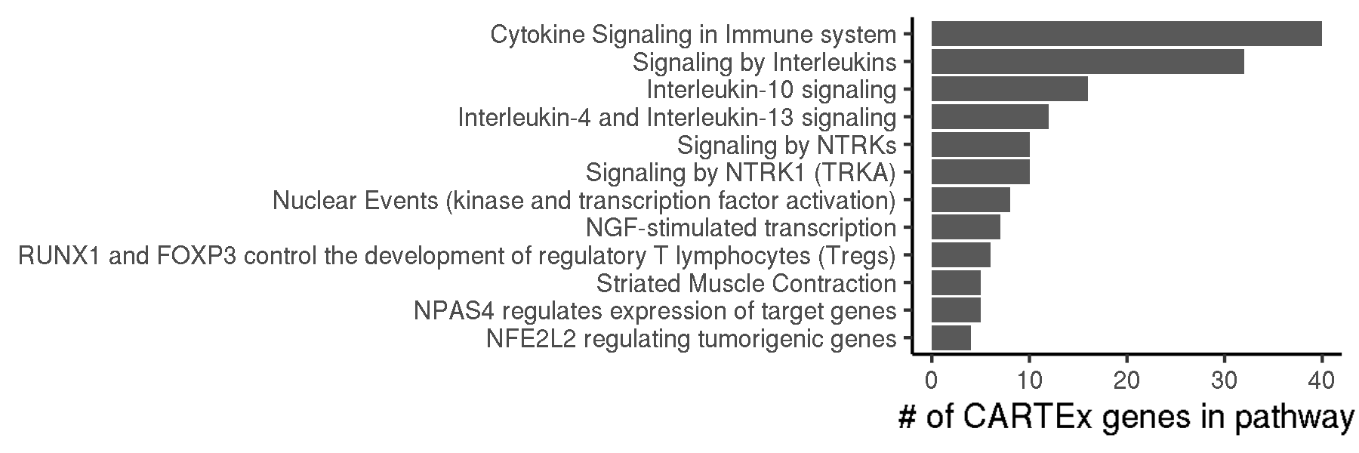
CARTEx project
Figure 2. Biological context / Evaluation with other exhaustion and cell state signatures
A
B
C
E
D
F

Slide 3
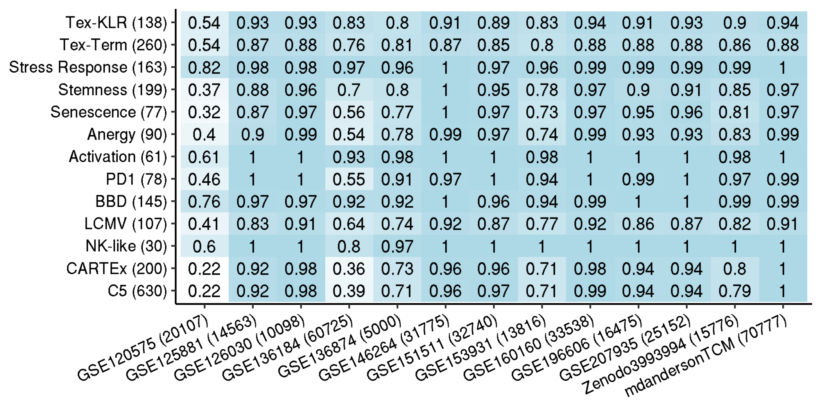
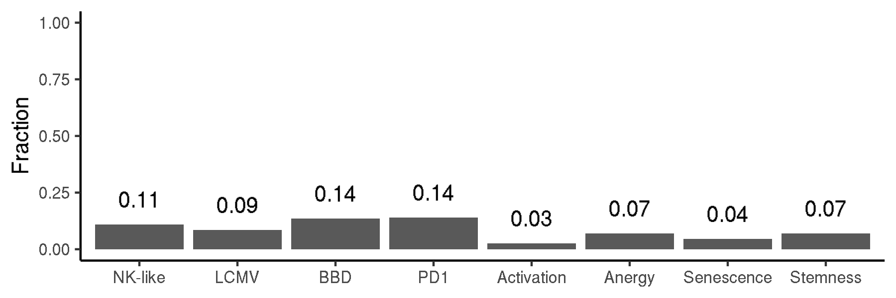
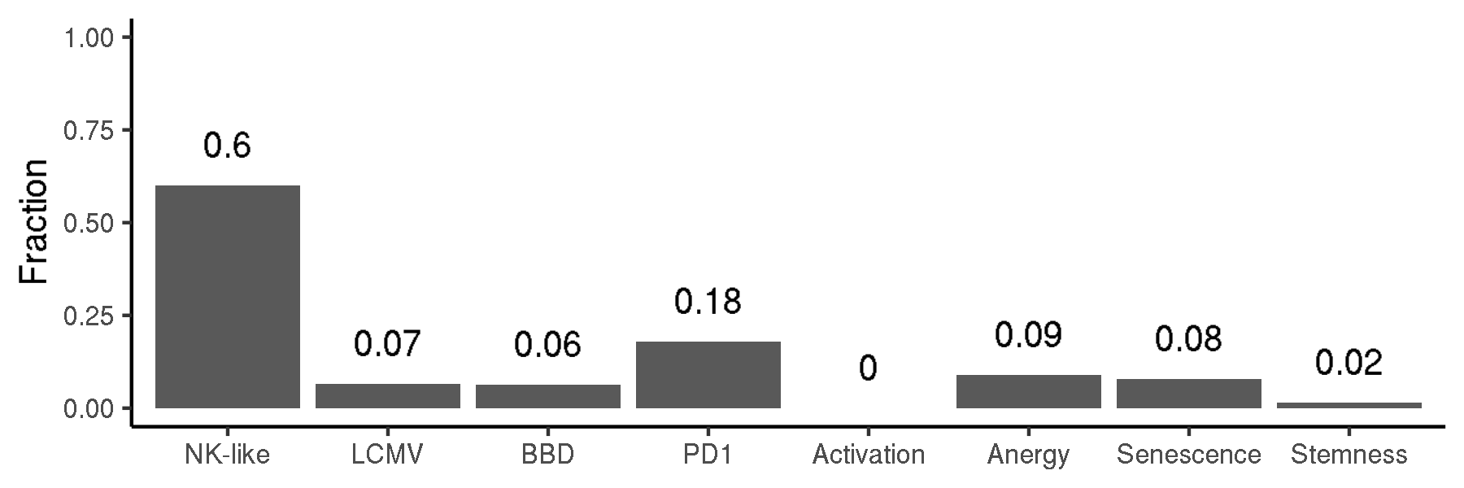
CARTEx project
Supplementary figures.

Slide 4
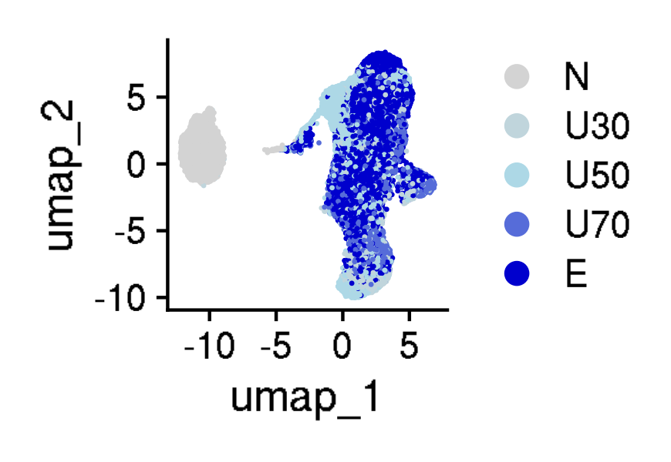
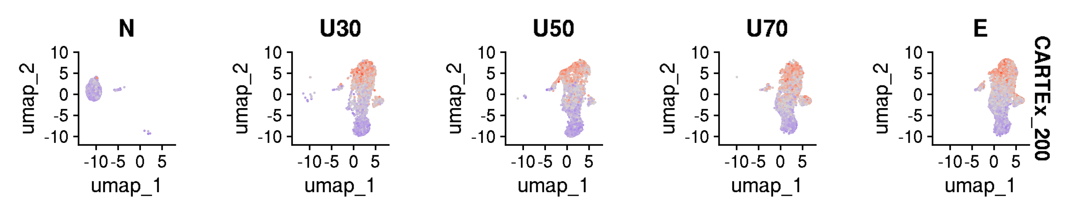
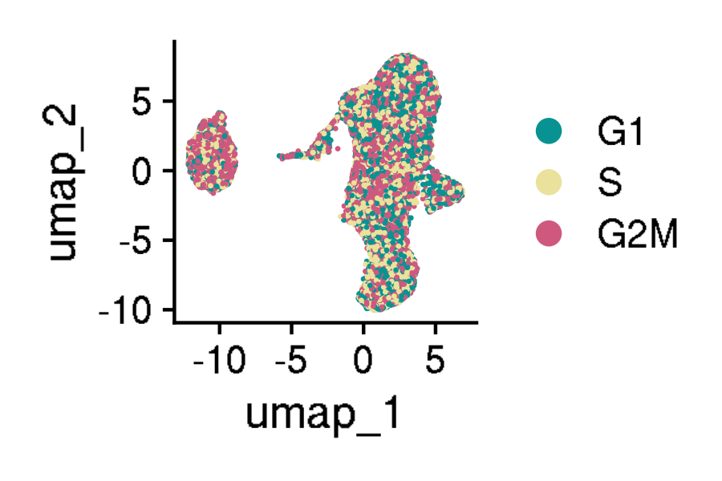
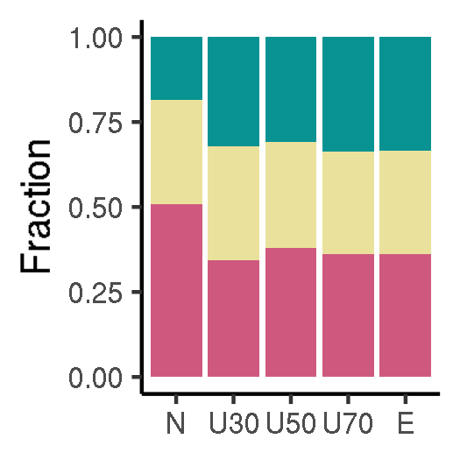
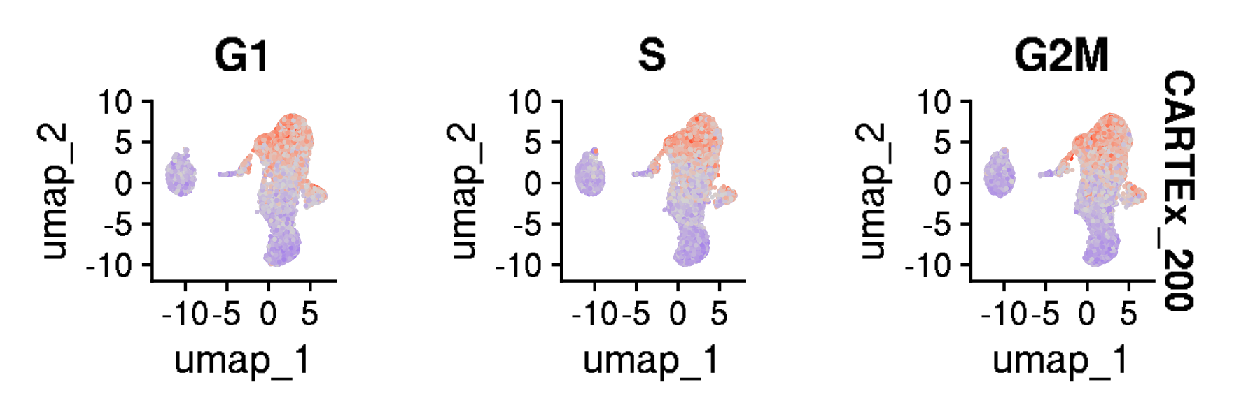
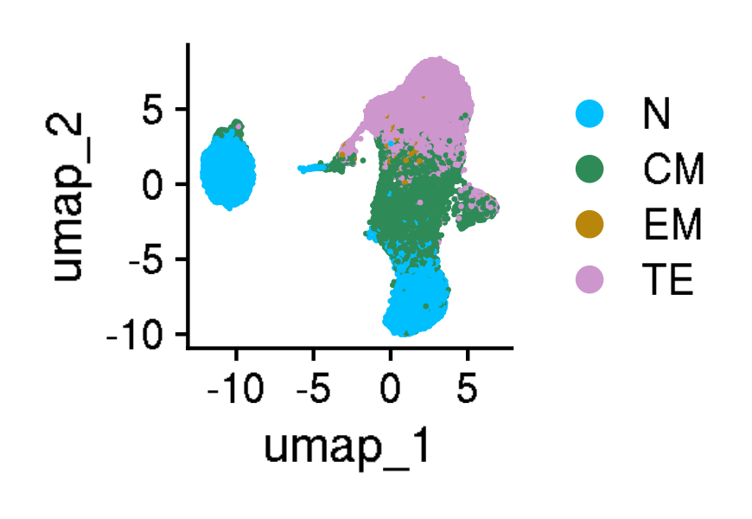
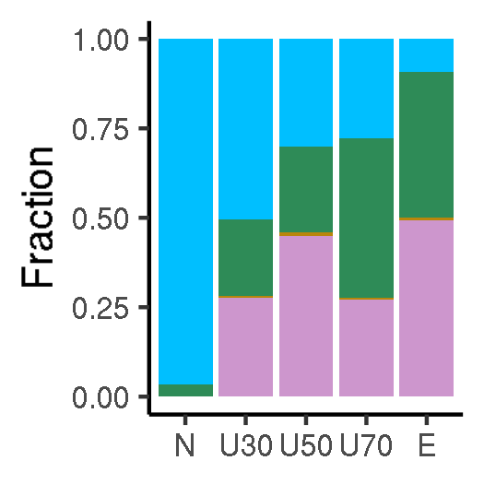
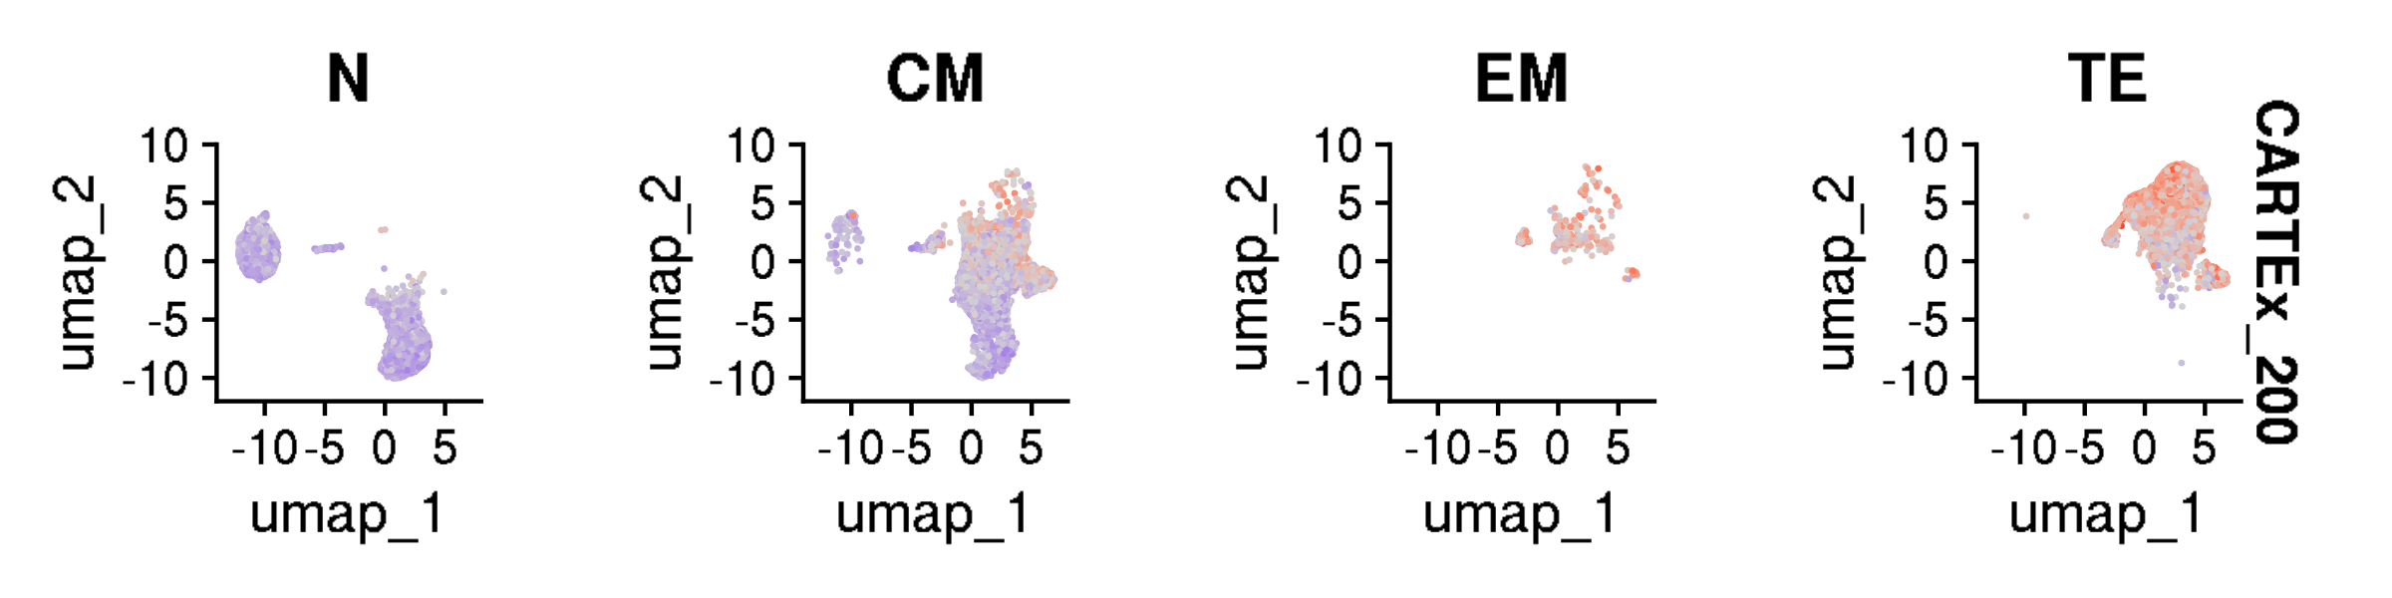
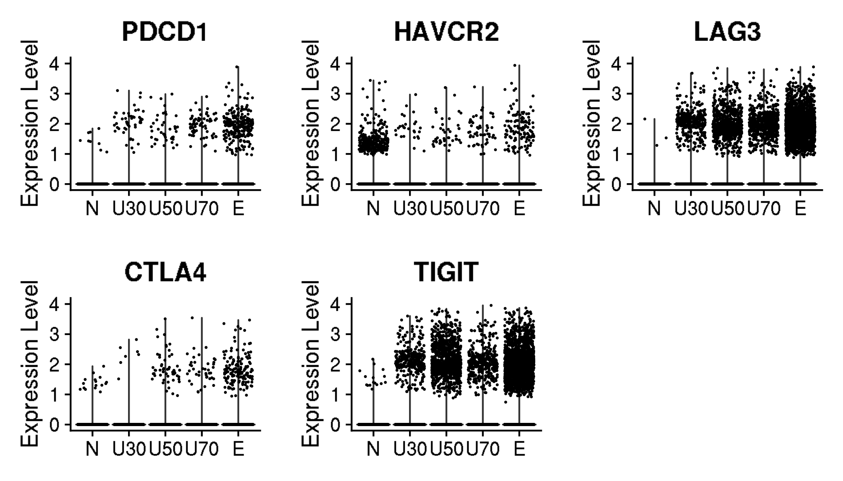
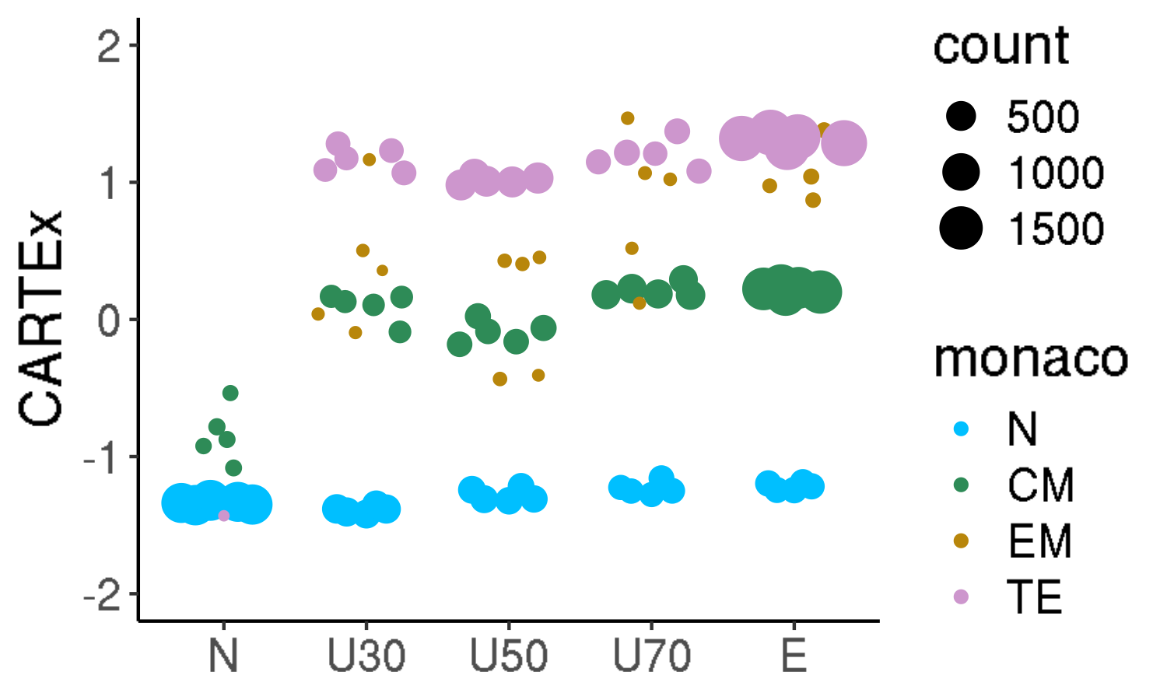
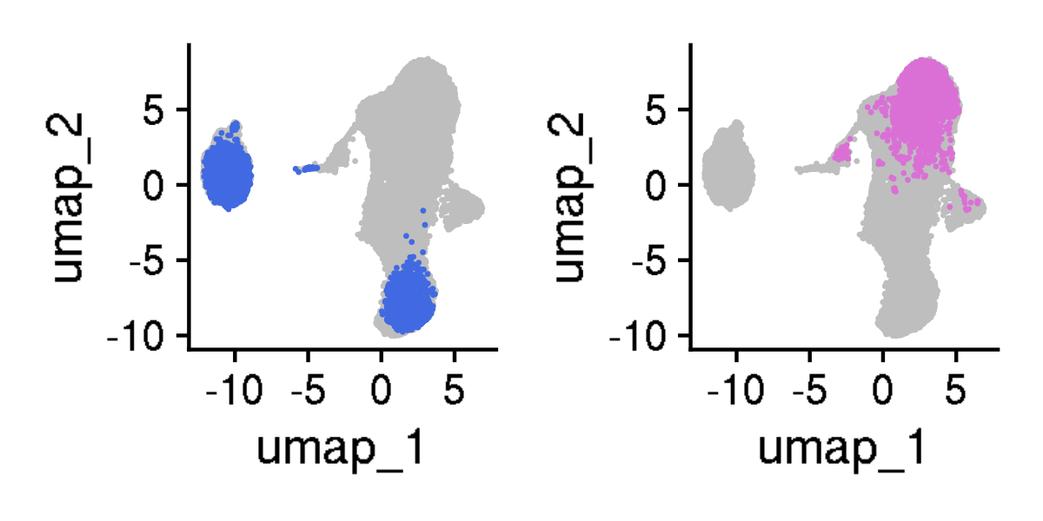
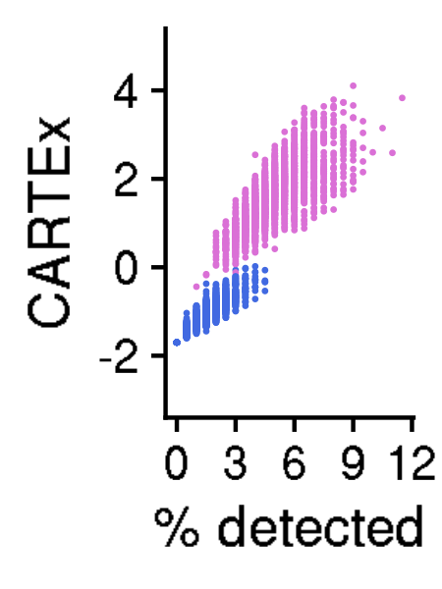
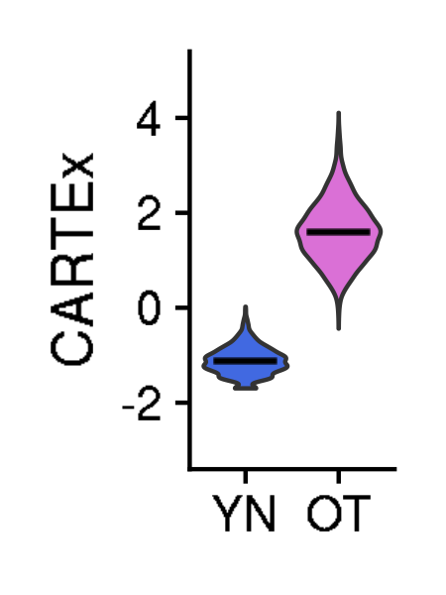
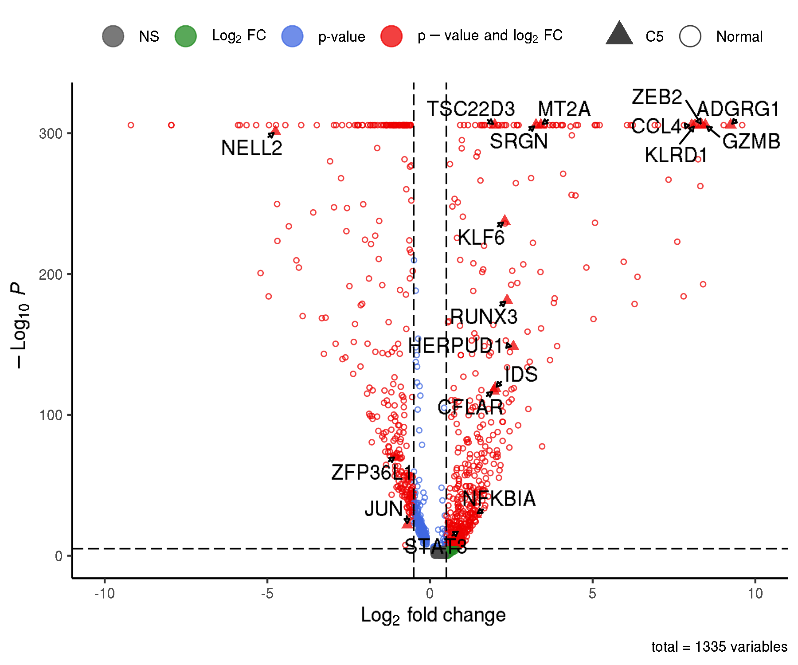
CARTEx project
Figure 4. T cell exhaustion is distinct from aging, cell cycle, and differentiation

Slide 5
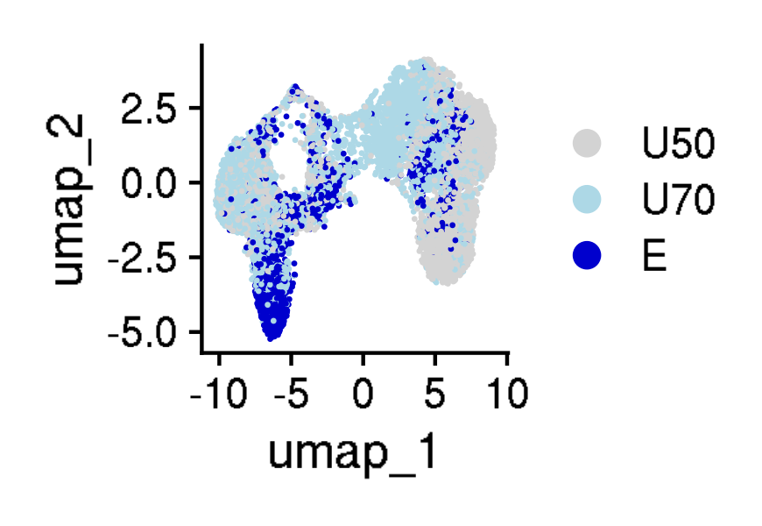
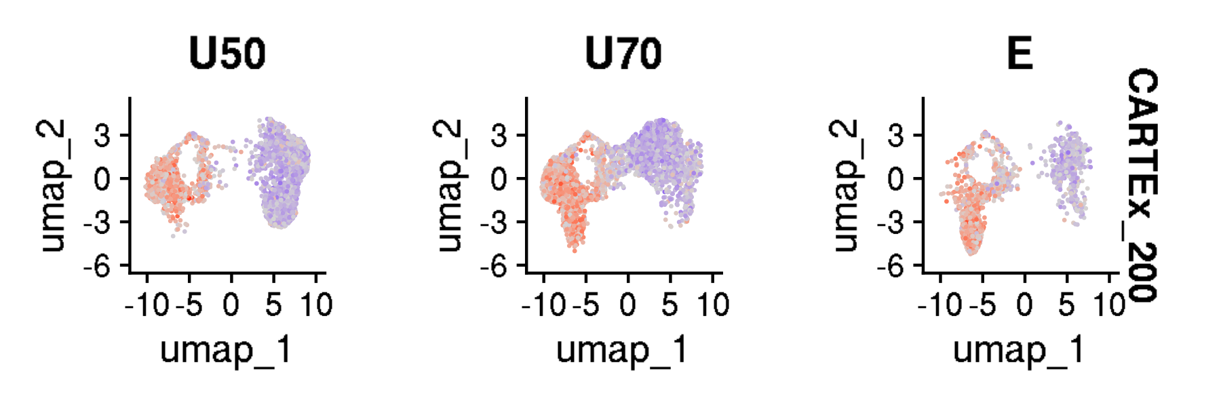
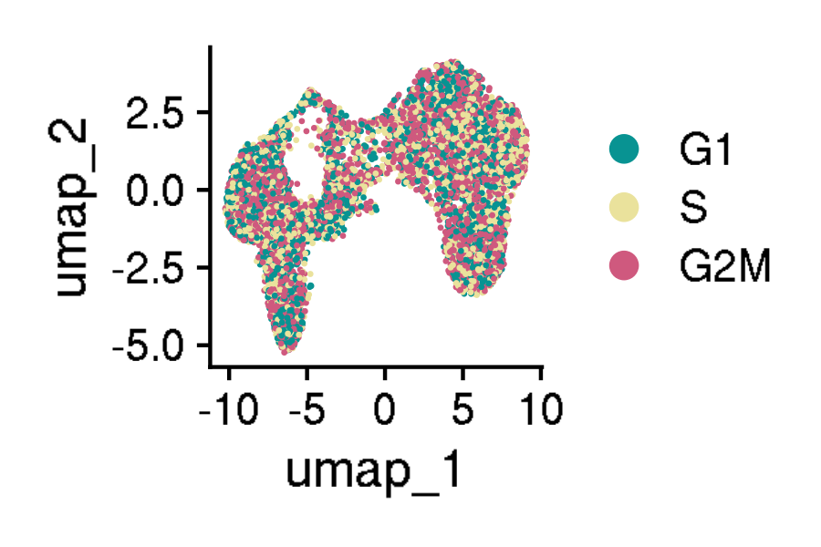
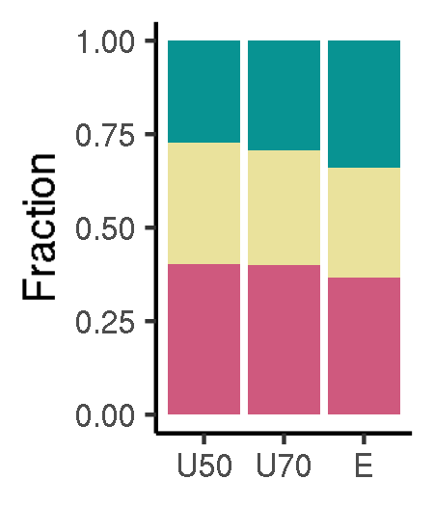
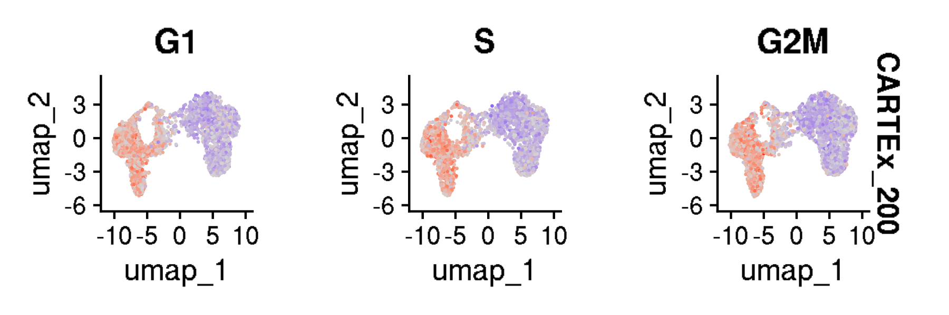
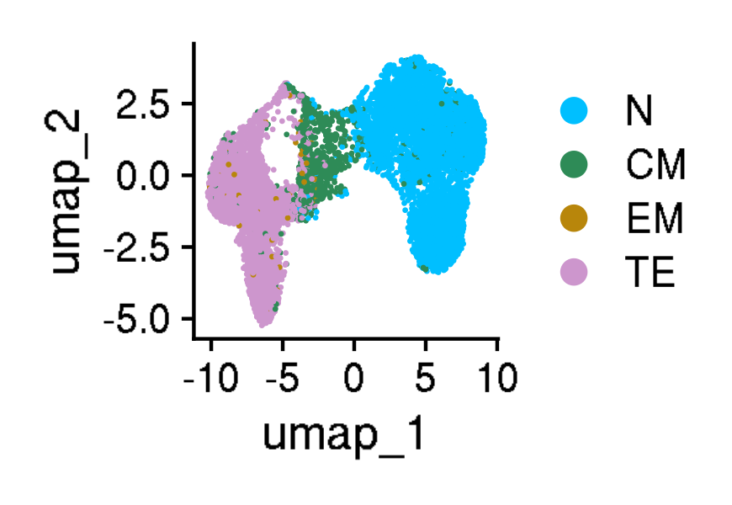
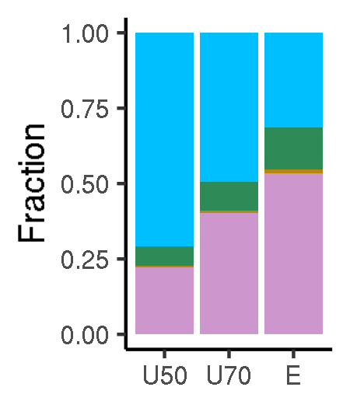
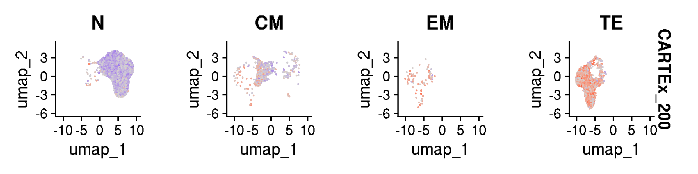
CARTEx project
Supplementary Figures for aging dataset

Slide 6
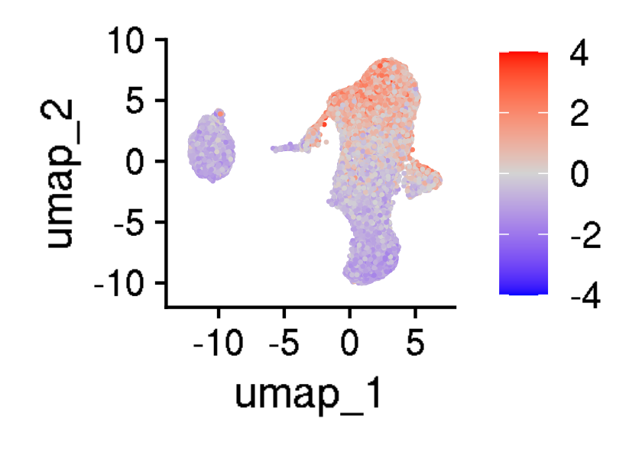
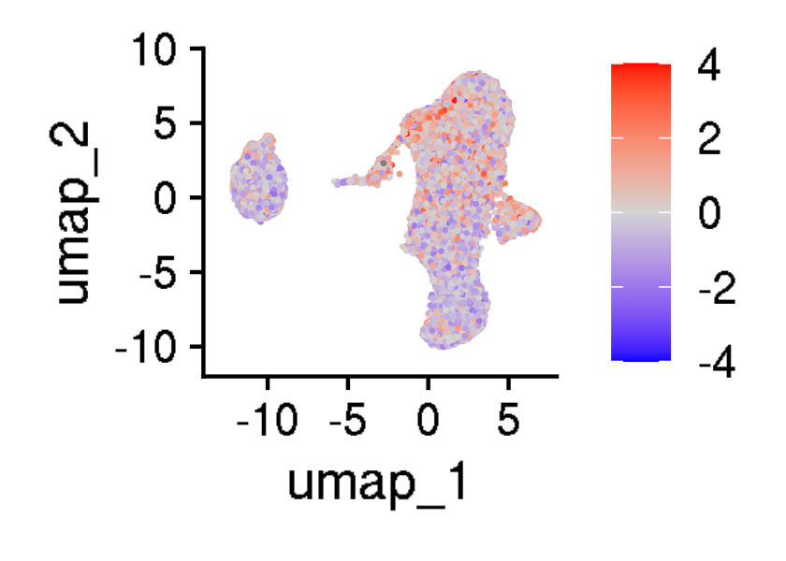
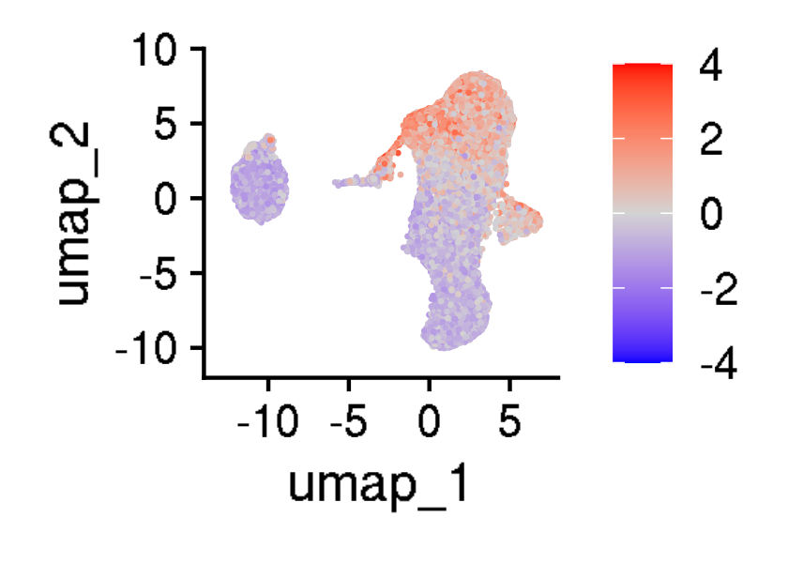
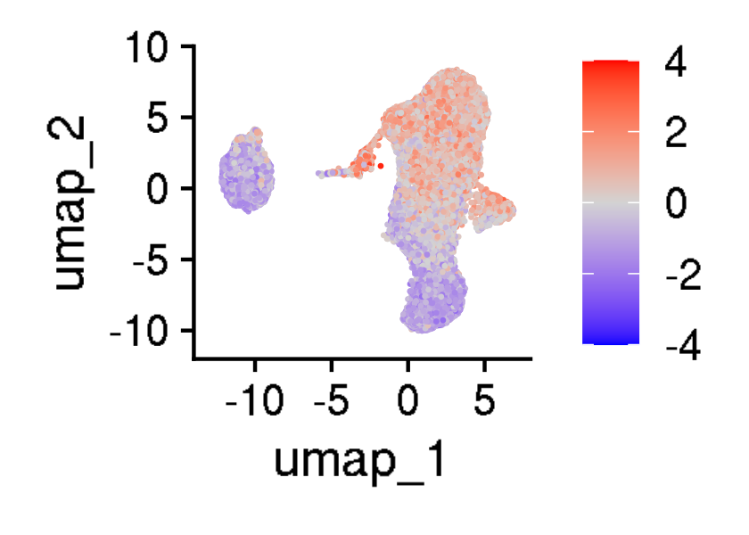

CARTEx project
Supplementary Figures for aging dataset

Slide 7
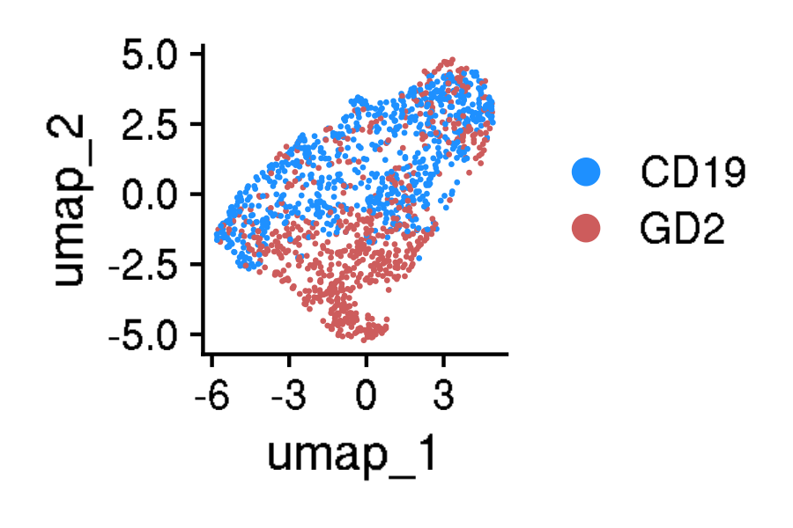
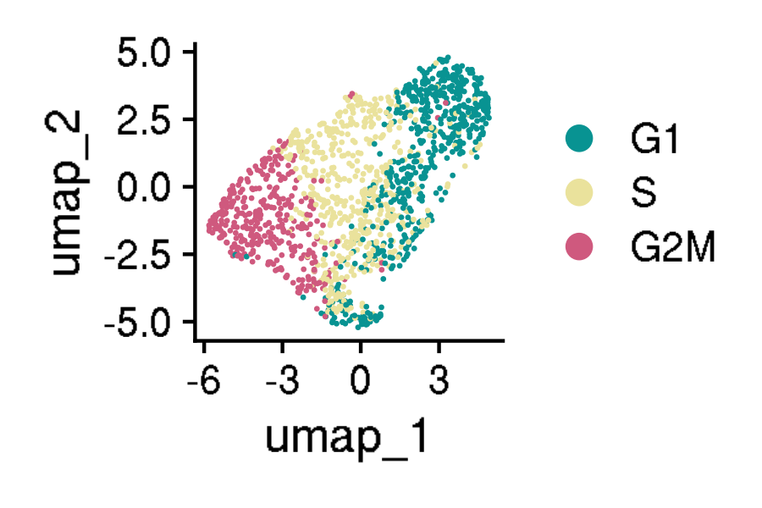
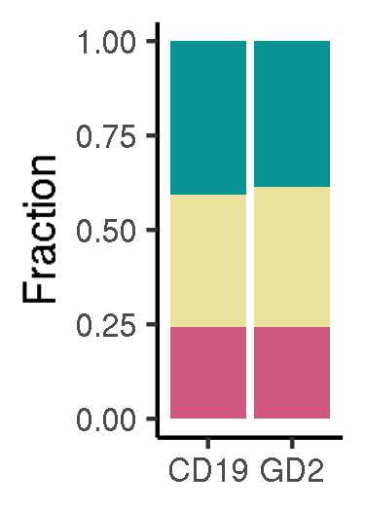

























CARTEx project
Figure 5. Validation in exhaustion-prone models

Slide 8








CARTEx project
Supplementary Figures for validation in exhaustion-prone models

Slide 9
























CARTEx project
Supplementary Figures for validation in exhaustion-prone models

Slide 10














CARTEx project
Supplementary figures. Activation and resting T cells from healthy donors

Slide 11













CARTEx project
Supplementary figures. T cells from healthy donors and cancer patients (MD Anderson pan-cancer)

Slide 12





























CARTEx project
Figure 6. CARTEx applied to clinical oncology

Slide 13





CARTEx project
Supplementary Figure for CARTEx applied to clinical oncology

Slide 14
























CARTEx project
Supplementary Figure for CARTEx applied to clinical oncology

Slide 15













CARTEx project
Supplementary Figure. COVID-19 severity and SARS-CoV-2-reactive T cell exhaustion

Slide 16












CARTEx project
Supplementary Figure for CARTEx applied to clinical oncology

Slide 17












CARTEx project
Figure 7. CARTEx applied to CD8 T cells in autoimmune disorders

Slide 18










CARTEx project
Supplementary Figure. More STAT3 GOF

Slide 19










CARTEx project
Supplementary Figure. Severe psoriasis is distinct from T cell exhaustion

Slide 20











CARTEx project
Supplementary Figure. BEACH domain deficiencies (autoimmunity caused by defective CTLA-4 trafficking)

Slide 21















CARTEx project
Supplementary Figure. T cell exhaustion in neurodegenerative diseases

